Slide 1
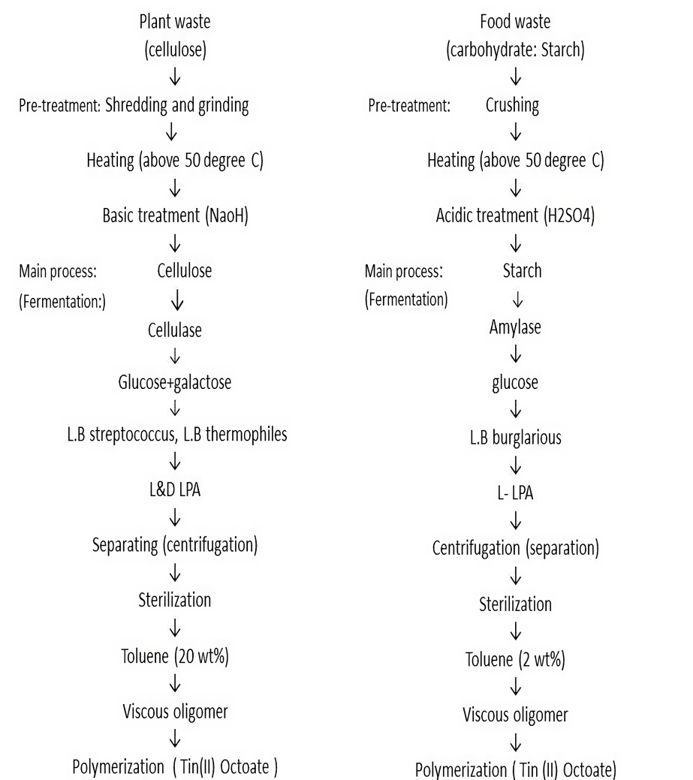
Multi-sectorial polymer
Poly Lactic acid
“In the world of, Transforming Nature's Waste into Sustainable Solutions – We produce high-quality Poly Lactic Acid (PLA) from biowastes such as food and plant waste, contributing to eco-friendly innovation across industries. Our initiative at Ganpat University focuses on transforming University’s waste into University’s wealth.
Why only PLA?
PLA is widely use in multiple industry like:
3D printing
Medical devices
Packaging materials
Textiles
Disposable tableware
Process
Why are we focused on L-PLA here?
L-PLA is type of PLA which is widely used:
Medical & Pharmaceutical sectors
3D Printing sectors
*As compare to D-PLA, L-LPA is very precious raw material

